Slide 1
Hospitality Dashboard Analysis
Group members
Rahul Deepak Kadu
Vishakha Priya
Vishal Radheshyam Singh
Dudi Mounisha
Ansh Balu Bachhe
Suma K T
Group 6

Slide 2
Agenda
Introduction
Key Performance Metrics
City-wise Performance
Hotel-wise Performance
Customer & Booking Behavior
Capacity & Utilization Analysis
Trend Analysis
Insights & Findings
Conclusion

Slide 3
Introduction
It brings together critical insights such as total bookings, revenue generation, occupancy percentage, cancellation trends, class-wise contribution, hotel-wise performance, and city-level demand behavior.
By visualizing these metrics in an interactive format, the dashboard helps identify strengths, weaknesses, and opportunities within the hospitality operations.
It helps identify trends, understand customer behavior, evaluate city and class-level revenue, and measure overall capacity utilization.
The insights support better decision-making in pricing, operations, and revenue management.

Slide 4
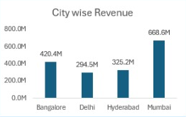
City-Wise Revenue Performance
City | Revenue | Insights
Mumbai | ₹668.6M | Highest demand, major market
Bangalore | ₹420.4M | Strong corporate + leisure mix
Hyderabad | ₹325.2M | Moderate performing city
Delhi | ₹294.5M | Underperforming for a metro city
Key Insights:
Mumbai alone contributes almost 40%+ of total city revenue.
Delhi’s lower revenue indicates:
Pricing issues
Seasonality
Weak brand presence.

Slide 5
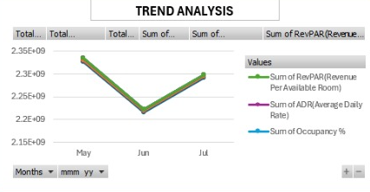
Trend Analysis (Monthly Revenue KPIs)
Months: May, June, July
Metrics:
RevPAR
ADR
Occupancy %
Findings:
May is the peak month in all metrics.
June shows dip (seasonal impact).
July recovers slightly.
Key Insight:
Strong seasonality is observed.
May–June–July cycle reflects:
holiday tourism behaviour,
monsoon impact,
business travel fluctuations.

Slide 6
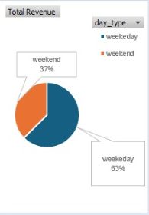
Day Type Revenue (Weekend vs Weekday)
Weekend: 37% Weekday: 63%
Insight:
Weekday demand is stronger due to business + corporate travelers.
Weekend demand is still good but needs:
holiday packages,
leisure offers,
discounts for families.

Slide 7
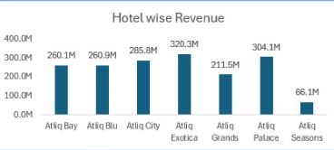
Hotel-Wise Revenue
Hotel | Revenue | Insight
Atliq Exotica | ₹320.3M | Top performer
Atliq Palace | ₹304.1M | Strong
Atliq City | ₹285.8M | Stable
Atliq Blu | ₹260.9M | Moderate
Atliq Bay | ₹260.1M | Moderate
Atliq Grands | ₹211.5M | Weak
Atliq Seasons | ₹66.1M | Serious under performance
Insights:
Atliq Exotica leads the chain—strong demand for premium-category properties.
Atliq Seasons is extremely low, indicating:
Location issues
Customer dissatisfaction
Outdated rooms or service
Wrong pricing strategy

Slide 8
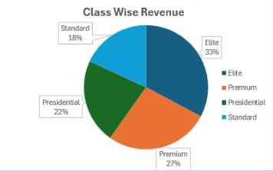
Class-Wise Revenue Distribution
Class | Share | Insight
Elite | 33% | Highest revenue → premium beds sell well
Premium | 27% | Strong mid-tier demand
Presidential | 22% | Luxury customers present
Standard | 18% | Lower performance compared to premium tiers
Key Insights:
Revenue is more from high-end categories, which is excellent.
Shows brand is positioned well for premium customers.
Standard rooms need repositioning or bundling.

Slide 9
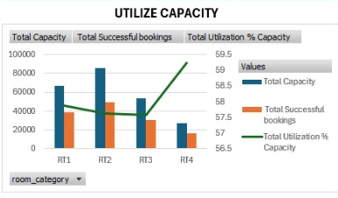
Utilize Capacity (Room Category Analysis)
Room Categories: RT1, RT2, RT3, RT4
Metrics included:
✔ Total Capacity ✔ Successful Bookings ✔ Utilization %
Observations:
RT1 → highest booking volume
RT4 → highest occupancy %
RT3 → lowest performance
Key Insight:
RT4 might be premium rooms with fewer units but higher demand.
RT3 needs:
better pricing,
promotions,
room refurbishments.

Slide 10
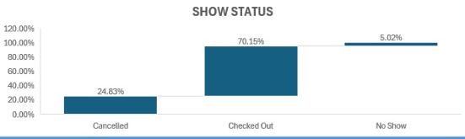
Show Status (Guest Booking Outcome)
Status | Percentage | Meaning
Cancelled | 24.83% | High loss of business
Checked Out | 70.15% | Successful stays
No Show | 5.02% | Rooms blocked but unsold
Key Insight:
No-shows + cancellations = ~30% loss of potential revenue.
Implement:
Partial advance payments
Stricter cancellation windows
Reminder notifications
Flexible rebooking options

Slide 11
Top-Level KPIs (Business Performance Summary)
Total Bookings: 134,590
Shows strong customer acquisition.
High booking volume indicates good marketing, OTA visibility, and brand awareness.
Important for demand forecasting and capacity planning.
Total Revenue: ₹1,70,87,71,229 (~₹1.71 billion)
Indicates strong financial performance.
High revenue driven by:
High ADR (Average Daily Rate)
Large number of total bookings
Premium class revenue share

Slide 12
.
Occupancy: 58%
A moderate occupancy level.
Indicates 42% room inventory is unused, signaling:
Inefficient capacity utilization
Pricing strategy gaps
Low weekday demand
Over supply in some seasons
Cancellation Rate: 25%
1 out of every 4 bookings gets cancelled.
This is significantly high.
Impacts:
revenue forecasting,
staffing,
inventory management,
peak season yield.

Slide 13
Deep Business Insights (Overall)
Strengths:
High premium class revenue (Elite + Premium = 60%)
Strong weekday revenue
Good performance in Mumbai & Bangalore
Atliq Exotica performing exceptionally well
Weaknesses:
Only 58% occupancy → lots of empty rooms
25% cancellation rate → revenue leakage
Delhi & Seasons hotel underperforming
No-show issue (5%) blocks inventory
Opportunities:
Dynamic pricing for weak months
Reduce cancellations via policies
Target corporate clients for weekday demand
Push promotions for RT3 & Standard rooms

Slide 14
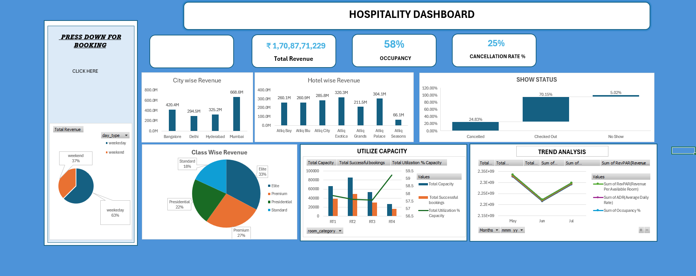
Excel Dashboard

Slide 15
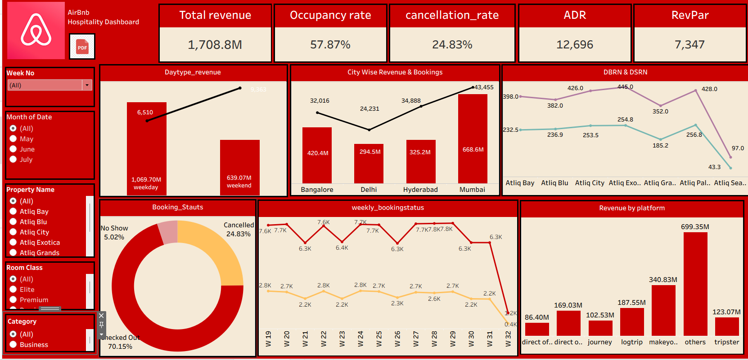
Tableau Dashboard

Slide 16
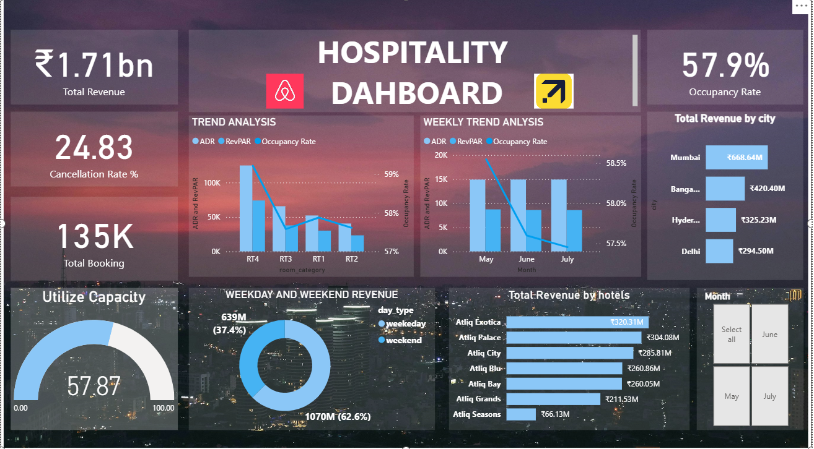
Power BI Dashboard

Slide 17
Conclusion
The dashboard shows strong revenue and booking performance but highlights challenges such as low occupancy and high cancellations.
Premium categories and major cities perform well, while some hotels lag behind.
Improving pricing, reducing cancellations, and optimizing capacity can significantly enhance overall business performance.

Slide 18
Thank You

